Slide 1
Canterbury Tales
Ali Adel Al Binali
12E

Slide 2
The knight
The Knight is the noblest of the pilgrims, embodying military prowess, loyalty, honor, generosity, and good manners. The Knight conducts himself in a polite and mild fashion, never saying an unkind word about anyone

Slide 3
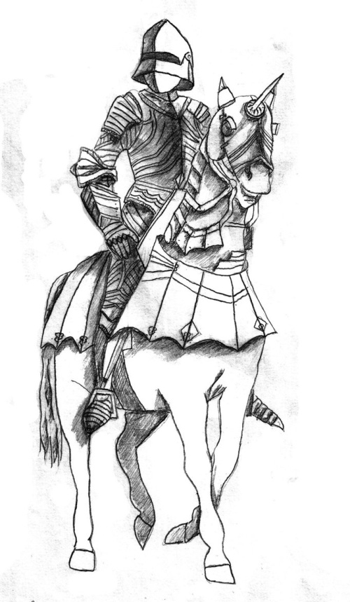

Slide 4
The Squire
The Knight’s son, who is about twenty years old, acts as his father’s squire, or apprentice. Though the Squire has fought in battles with great strength and agility, like his father, he is also devoted to love.

Slide 5
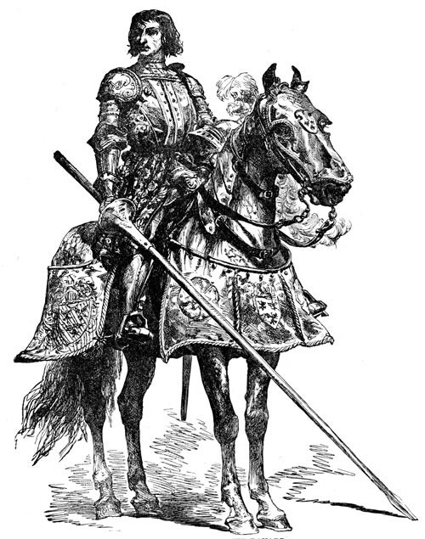

Slide 6
The Yeoman
The Yeoman wears green from head to toe and carries an enormous bow and beautifully feathered arrows, as well as a sword and small shield. His gear and attire suggest that he is a forester.

Slide 7
