Slide 1
Research
Ali Adel AlBinali
Mrs. Timm
12E
January 19th, 2014

Slide 2
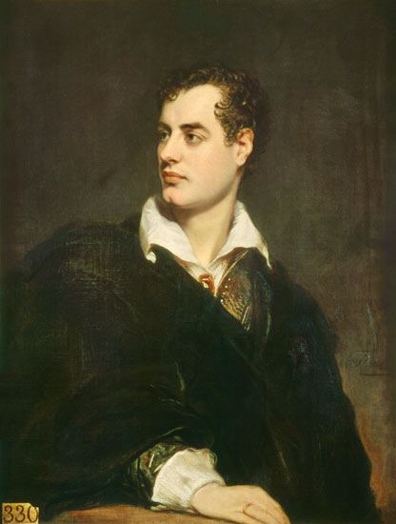
Introduction
“ If I don’t write to empty my mind, I go mad”
Lord Byron, George Gordon
English poet
Born on January 22nd, 1788
Died on April 19th, 1824
Notes:
George Byron which was know as Lord Byron was an English poet. He was born on January 22nd 1788. He died on April 19th 1824 due to high fever. His poetry was very famous In Europe. He supported romanticism. Like any other poet, through his life time Lord Byron proved his existence in his writings. (poets.org)

Slide 3
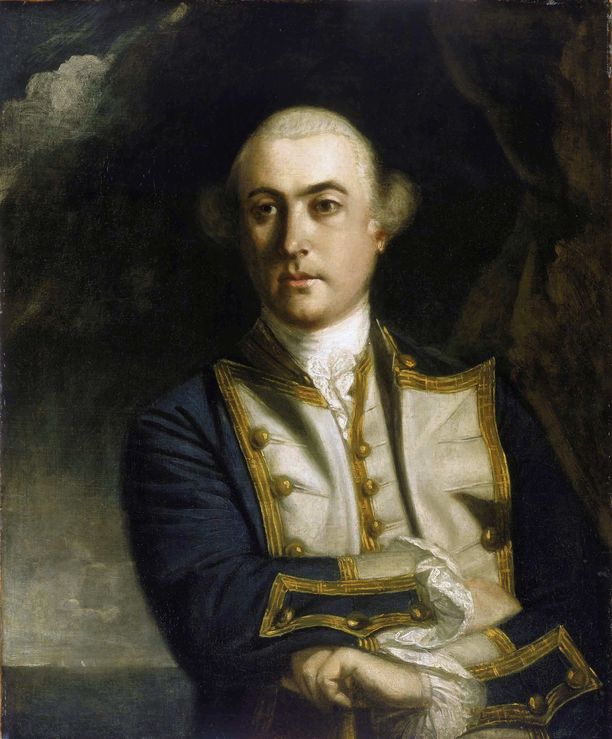
Family
Captain John Byron, Mad Jack- Father
Catherine Gordon- Mother
Anna Isabella Byron- wife
Augusta- half sister
Ada Lovelace, Elizabeth Medora Leigh, Allegra Byron- children
Notes:
Lord Byron’s father was Captain John Byron. He was a British army officer. Lord Byron’s mother was Catherine Gordon. She was a Scottish noblewoman. He got married a lot, one of his wife’s
is Anna Isabella Byron. His three daughters are Ada Lovelace, Elizabeth Medora Leigh, and Allegra Byron. (biography.com)

Slide 4
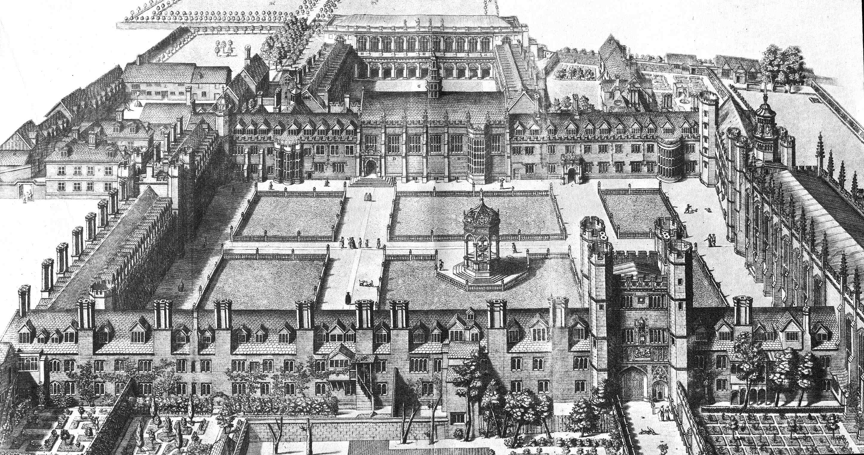
Education
Harrow School 1801-1805
Trinity College, Cambridge 1805-1808
Notes:
Lord Byron was an educated poet. He went to Harrow School during 1801 to 1805. Later he followed with Trinity College in Cambridge. He published some works in an early age of 14 years old. He tried to get knowledge not only by attending to school. He read and explored more about poetry. Lord Byron looked mostly into romanticism.(poemhunter.com)

Slide 5
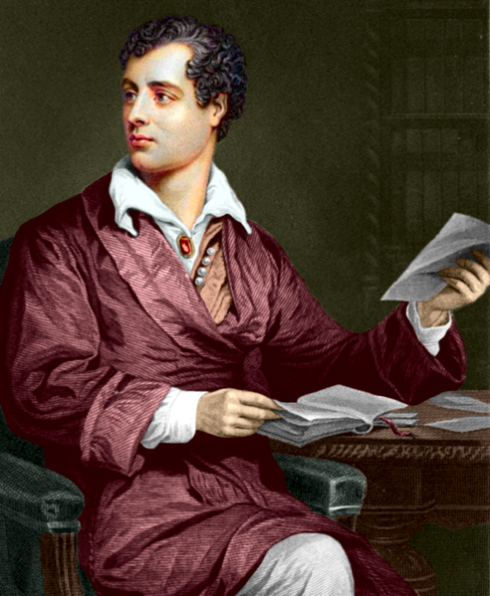
Career
Poet
He was a romantic paradox
Established his own characters that earned him the title of Byronic Hero
Notes:
George Gordon did not have a specific career. He was known as a poet and a writer. He was also a romantic paradox. His poetry included main characters that earned him the title of Byronic Hero. He had a seat in the House of Lords. Lord Byron and some other lords sailed across Europe. In every stop in he wrote some poetry.(poemhunter.com)

Slide 6
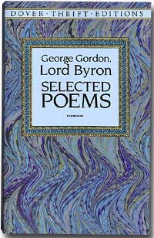
Interests and Accomplishments
Interested in writing
  Poetry
    First volume poetry titled Fugitive Pieces
Traveling around the world
Acting
  He even acted in two plays that were organized by the community.
Notes:
Lord Byron was interested in many fields. His main field was poetry. He wrote romantic poems, a lot of them described love between two couples. He loved travelling around the world. He lived in Italy for seven years, and later joined a war fighting the Ottoman Empire. He was in interested in acting too. He acted in two plays that were organized by the community. One of his major poetry was Fugitive Pieces, it was very popular. (poetryfoundation.org)

Slide 7
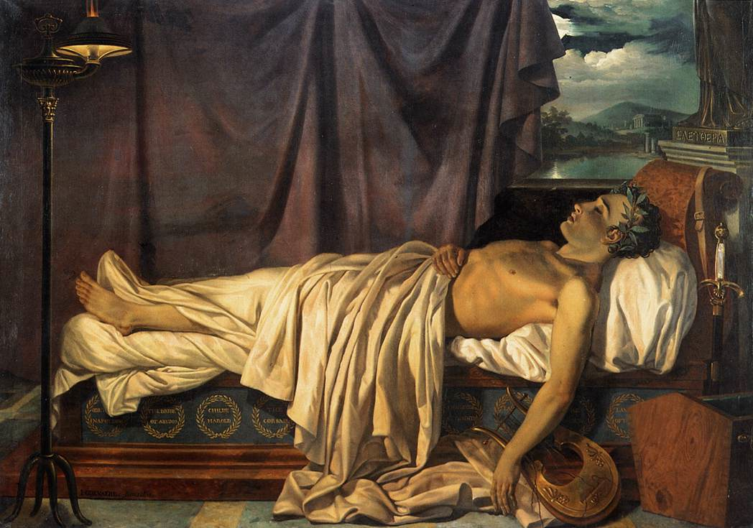
Later Years
Illness
  Byron fell ill with a fever.
Doctors tried their best
Death
  April 19, 1824
  Age 36
Notes:
Lord Byron's later years were filled with illness. He had a strong fever that continued for weeks. Doctors tried their best to save his life, but it was inefficient. After ten days George Gordon’s soul rested in peace. He died age of 36 that was on April 19th 1824.(englishhistory.net)

Slide 8
Conclusion
Lord Byron born on January 22nd 1788
English poet
Wrote romantic poetry
Interested in traveling around the world
Fever caused his death
Notes:
In cocnlusion, Lord Byron was an English poet that was born on January 22nd 1788. he wrote romantic poetry. He was interested in traveling around the world. He was an inspiration or an idol to a lot of people. Fever cause his death. He rested in peace on April 19th 1824.(poets.org)

Slide 9
Work cited
"George Gordon Byron." Poets.org. Academy of American Poets, n.d. Web. 19 Jan. 2014.
"Lord Byron Biography." Bio.com. A&E Networks Television, n.d. Web. 19 Jan. 2014.
"Lord Byron (George Gordon)." : The Poetry Foundation. N.p., n.d. Web. 19 Jan. 2014.
The Life and Work of Lord Byron (1788-1824)." The Life and Work of Lord Byron (1788-1824). N.p., n.d. Web. 16 Jan. 2014.

Slide 10
Continuation..
"Missolonghi Memoirs: Lord Byron in Greece." Missolonghi Memoirs: Lord Byron in Greece. N.p., n.d. Web. 19 Jan. 2014.
George Gordon Byron, 6th Baron Byron (English Poet)." Encyclopedia Britannica Online. Encyclopedia Britannica, n.d. Web. 19 Jan. 2014.
"Romantic Circlesbeta." 1778-1800. N.p., n.d. Web. 19 Jan. 2014
"Lord Byron." Lord Byron. N.p., n.d. Web. 19 Jan. 2014.

